Slide 1
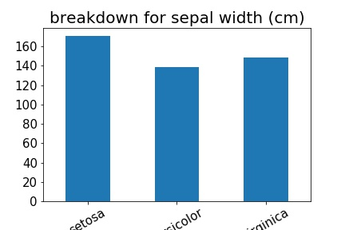
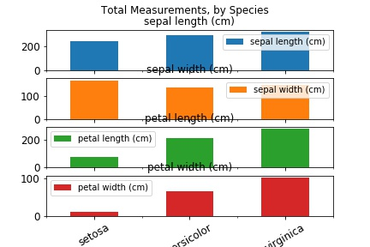
Used to represent the relative relationship between elements.
The most important part is the axes labels and color of bars to convey meaning.

